Slide 1
IBM University Engagement Project Submission
“IntelliCheck AI - AI-Driven Plagiarism Intelligence for Assignments”

Slide 2

Project Tile – IntelliCheck AI - AI-Driven Plagiarism Intelligence for Assignments
Domain of Project – Education
Student Name | Recent Passport Photo | Email ID | Mobile number [WhatsApp]
Debabrata Kuiry |  | debabratakuiry2002@gmail.com | 8637067507

Slide 3
Problem Statement – 10
Problem Statement : AI-Driven Plagiarism Intelligence for Assignments
The Challenge
Academic institutions face increasing difficulty in detecting plagiarism, AI-generated content, and sophisticated paraphrasing in student assignments. Traditional plagiarism tools often fail to understand context, instructor expectations, and evolving AI writing patterns.
The Objective
Develop an intelligent academic integrity system that:
Detects plagiarism and content duplication.
Identifies AI-generated writing indicators.
Recognizes paraphrased and suspicious content.
Evaluates writing consistency.
Learns from historical academic integrity cases.
Supports faculty with contextual risk assessments.
Generates actionable academic integrity reports.

Slide 4
Technology Used
Tech Stack
Technology Used
IBM Cloud Lite
IBM watsonx Orchestrate
IBM watsonx.ai
IBM Granite Foundation Models
Knowledge Base (RAG-style retrieval)
Multi-Agent Architecture
Prompt Engineering
Academic Integrity Knowledge Repository
IBM watsonx Orchestrate
Used for creating and managing intelligent academic integrity agents.
IBM Granite Models
Used for reasoning, classification, report generation, and content analysis.
IBM Cloud Lite
Provides cloud infrastructure and deployment environment.
Knowledge Base
Stores academic policies, plagiarism cases, and faculty guidelines.
Agentic AI
Coordinates multiple specialized agents for assignment evaluation.

Slide 5
Proposed Solution -
Proposed Solution – IntelliCheck AI
IntelliCheck AI is an AI-powered academic integrity system that analyzes student assignments for plagiarism, AI-generated content, paraphrasing, and writing inconsistencies. The system combines multiple specialized agents to perform comprehensive academic integrity analysis.
Key Features
Writing Quality Assessment
AI Content Detection
Similarity Analysis
Academic Risk Classification
Faculty Recommendation Generation
Academic Integrity Reporting
The solution provides faculty members with contextual and explainable decisions instead of simple similarity percentages.

Slide 6
IBM watsonx Orchestrate Components Used
1) Chat Input
Interface where students, faculty, or reviewers submit assignment text, essays, reports, and research papers for academic integrity analysis.
2) Assignment Integrity Agent
Main AI agent built in IBM watsonx Orchestrate that coordinates plagiarism detection, AI-content assessment, similarity analysis, and risk evaluation.
3) Foundation Model
IBM Granite Model (Prompt Lab) and GPT-OSS 120B (Orchestrate Runtime) used for assignment analysis, reasoning, report generation, and academic integrity assessment.
4) Chat Output
Generates a structured Academic Integrity Report containing:
Writing Quality Assessment
Similarity Analysis
AI Content Indicators
Risk Level
Faculty Recommendation
Final Verdict
5) Knowledge Component
Stores and retrieves academic integrity guidelines, institutional policies, sample assignments, faculty feedback, and reference documents used for contextual analysis.
6) Additional Components Used
IBM watsonx Prompt Lab
Prompt engineering
Testing plagiarism-analysis prompts
Model experimentation
IBM watsonx Orchestrate
Agent creation
Workflow management
Deployment and testing
IBM Cloud Lite Services
Cloud-based deployment and hosting environment

Slide 7
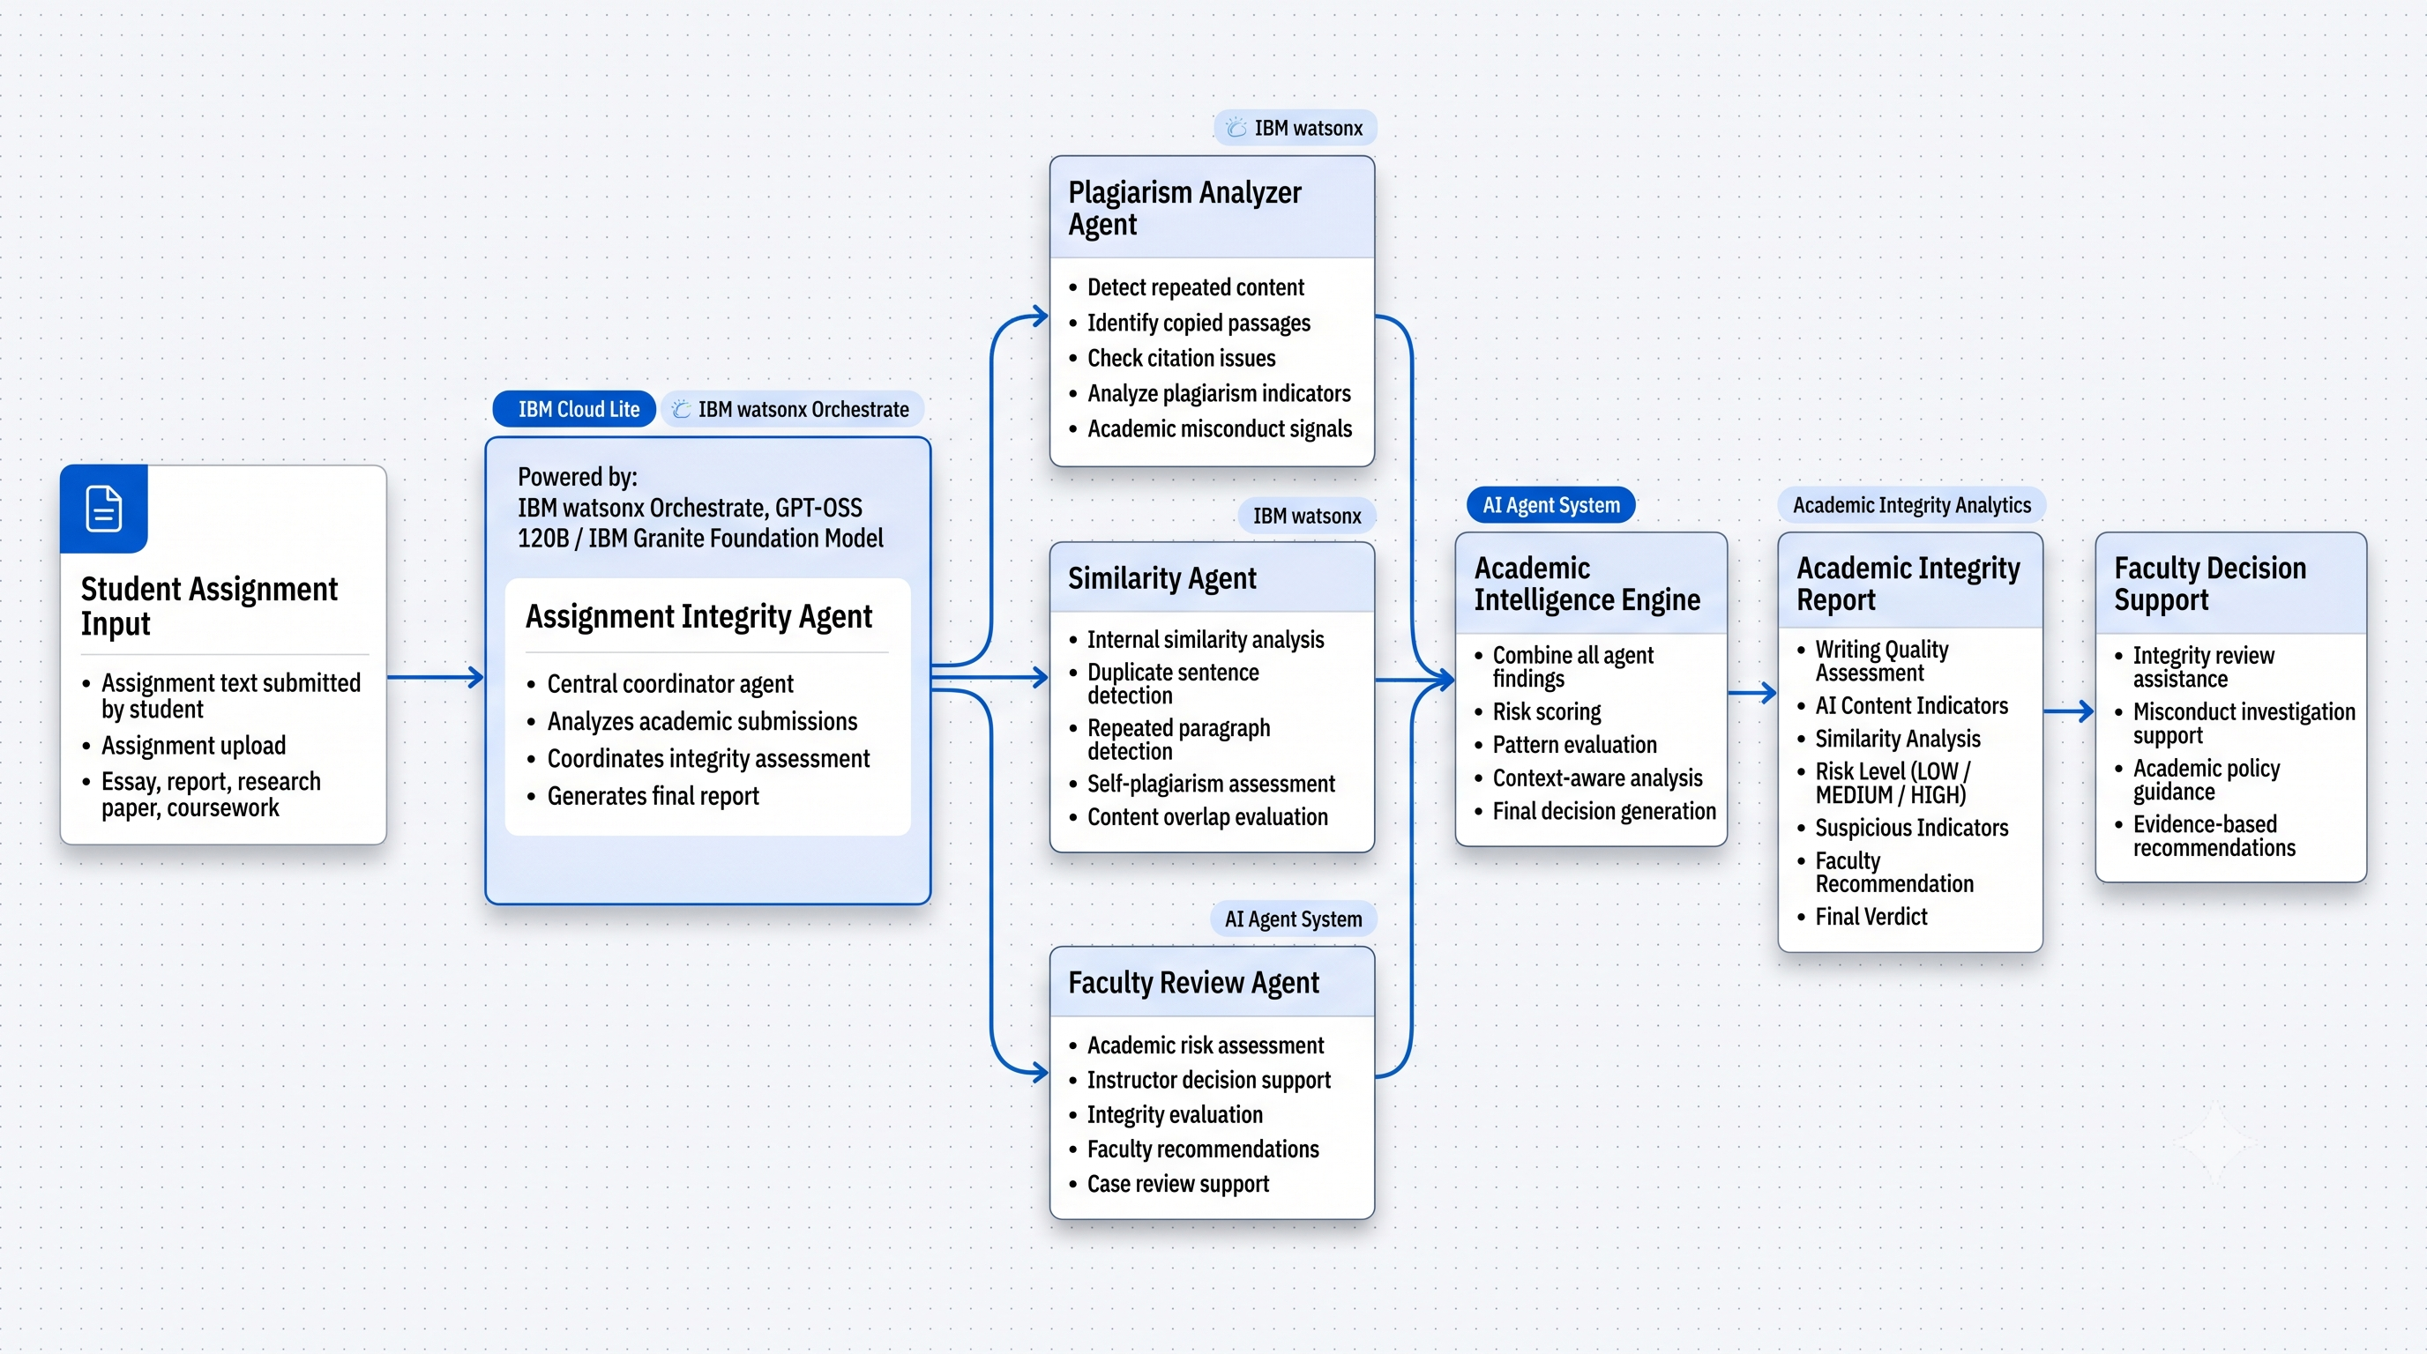
IBM Orchestrate workflow

Slide 8
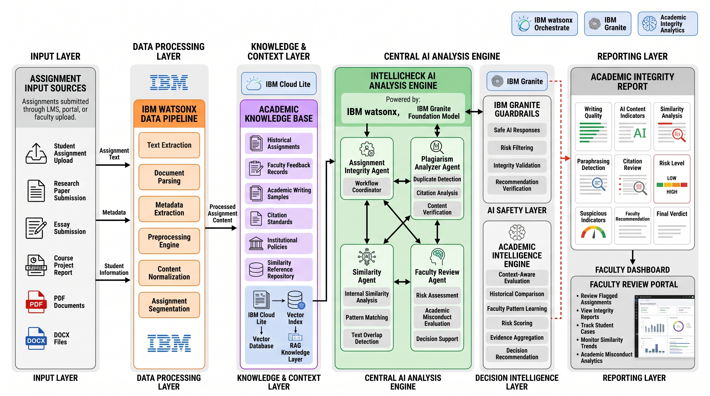
Architecture blueprint

Slide 9

Role of Agentic AI in the solution
Role of Agentic AI in Plagarism Agent
Assignment Integrity Agent acts as the central coordinator for academic integrity analysis.
Autonomously evaluates assignments for plagiarism indicators, content duplication, and writing inconsistencies.
Performs similarity analysis to detect repeated or suspicious content patterns.
Assesses AI-generated content indicators through contextual language analysis.
Generates structured Academic Integrity Reports with risk levels and supporting evidence.
Provides faculty decision support through recommendations and academic misconduct alerts.
Improves contextual awareness by utilizing institutional guidelines and academic integrity knowledge sources.
Reduces manual review effort while enabling faster and more consistent evaluation of student submissions.

Slide 10
Novelty and Uniqueness
The proposed IntelliCheck AI solution stands out by combining Agentic AI, academic integrity intelligence, and contextual analysis into a single intelligent platform for assignment evaluation.
Multi-Agent Intelligence – Instead of relying on a single plagiarism checker, multiple specialized AI agents collaborate to analyze writing quality, similarity patterns, AI-generated content indicators, and academic misconduct risks.
Context-Aware Analysis – Goes beyond keyword matching by evaluating writing structure, content consistency, duplication patterns, and suspicious academic behaviors within the assignment.
Academic Integrity Intelligence – Generates comprehensive Academic Integrity Reports containing risk assessments, suspicious indicators, and evidence-based faculty recommendations.
Faculty Decision Support – Assists educators by providing actionable insights and investigation guidance rather than only reporting similarity percentages.
Knowledge-Driven Evaluation – Utilizes academic integrity policies, citation guidelines, and institutional standards to provide more informed assessments.
Adaptive Risk Classification – Categorizes submissions into LOW, MEDIUM, or HIGH risk levels based on multiple integrity indicators instead of a single metric.
IBM-Powered Architecture – Built using IBM Cloud Lite, IBM watsonx Prompt Lab, and IBM watsonx Orchestrate, ensuring scalability, governance, and enterprise-grade AI capabilities.
Practical Academic Impact – Reduces manual review effort, improves consistency in assignment evaluation, and strengthens institutional academic integrity processes.
This makes IntelliCheck AI an intelligent academic integrity assistant that provides contextual analysis and decision support, rather than functioning as a traditional plagiarism detection tool.

Slide 11
Future Scope
Historical Learning & Faculty Feedback Enable the system to learn from past assignments and instructor feedback for more accurate academic integrity assessment.
LMS Integration Integrate with Moodle, Canvas, and Google Classroom for automatic assignment screening and report generation.
Multilingual Analysis Support plagiarism and AI-content detection across multiple languages.
Advanced IBM Granite Integration Leverage future IBM Granite models for improved reasoning, contextual analysis, and risk assessment.
Academic Integrity Dashboard Provide institutions with analytics on plagiarism trends, risk levels, and misconduct patterns.
·
·
·

Slide 12
GitHub Link
GitHub Repository URL – https://github.com/cyrax3589/IntelliCheck-AI
·
·

Slide 13


